Slide 1
Alignment (II) Bioinformatics Applications (PLPTH813)
Sanzhen Liu
2/16/2023

Slide 2
Alignment I - review
The local alignment algorithm, Smith–Waterman algorithm, ensures the best performance on accuracy and the most precise results with respect to its scoring scheme but it is very time-consuming.
BLAST is a seed-extension algorithm for database searching.
Identify a match for the seed sequence
Extend match using a local alignment
However, BLAST is still not fast enough for efficient alignments of millions of NGS reads.

Slide 3
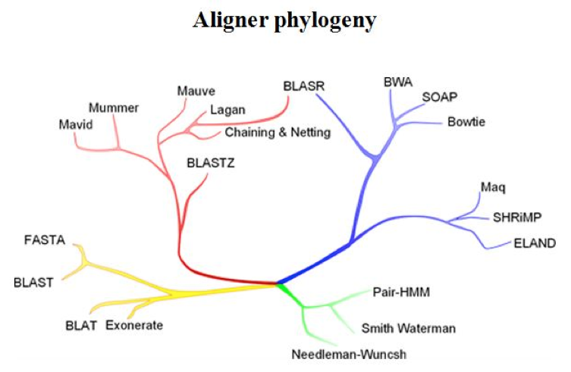
Relationship among different algorithms
Long sequences Short reads
Pairwise heuristic Sensitive aligners
http://evomicsorg.wpengine.netdna-cdn.com/wp-content/uploads/2014/01/alignCompare2.jpg

Slide 4
Outline
One of short-read alignment algorithms – BWT
A short-read aligner - BWA
Standard alignment format – SAM and BAM
A tool to handle alignments - SAMtools
An alignment visualization tool - IGV

Slide 5
Alignment is a central step for most NGS analyses
Sequencing reads
(typically million reads)
Alignments
Variants (SNPs)
gene expression
sequence assembly
reads aligned to reference sequences
reads aligned each other

Slide 6
Short-read alignments
“Sorting or indexing” genome sequences in a smart way to accelerate the alignment
Keeping the “Sorting or indexing” data at a reasonable size
memory
Human: ~2 gigabytes
Wheat: >15 gigabytes
“sorted or indexed” genome
Genome sequences
Gb genome
one by one
millions
billions
reads
alignments
3. A good aligner needs to find a good tradeoff between Speed and Accuracy.

Slide 7


Indexing speeds up searching
un-indexed library
indexed library

Slide 8
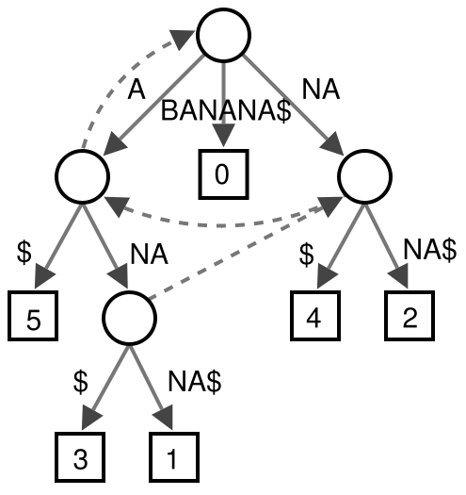
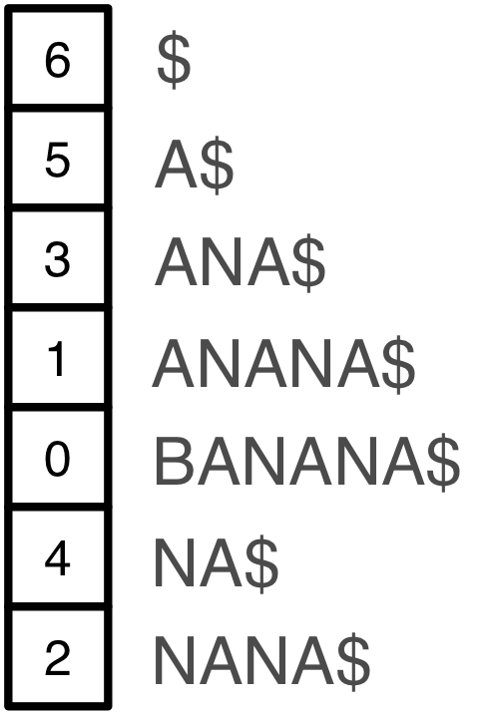
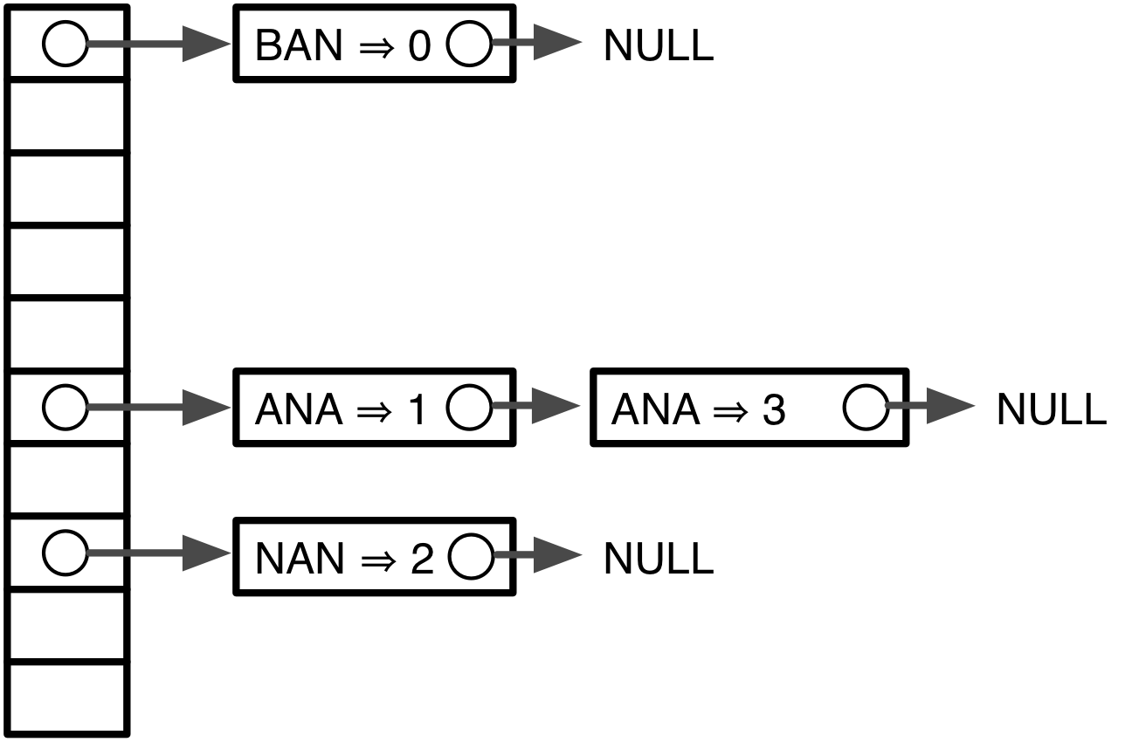
Indexing algorithms
A benefit of string indexing is to avoid scanning the whole reference. Therefore, alignment searching is much faster.
BWT Suffix Tree Suffix Array Hash table
Input | BWT
^BANANA| | BNN^AA|A
<2 gigabytes >35 gigabytes >12 gigabytes >12 gigabytes
Human genome memory footprint*
* From Bowtie poster

Slide 9
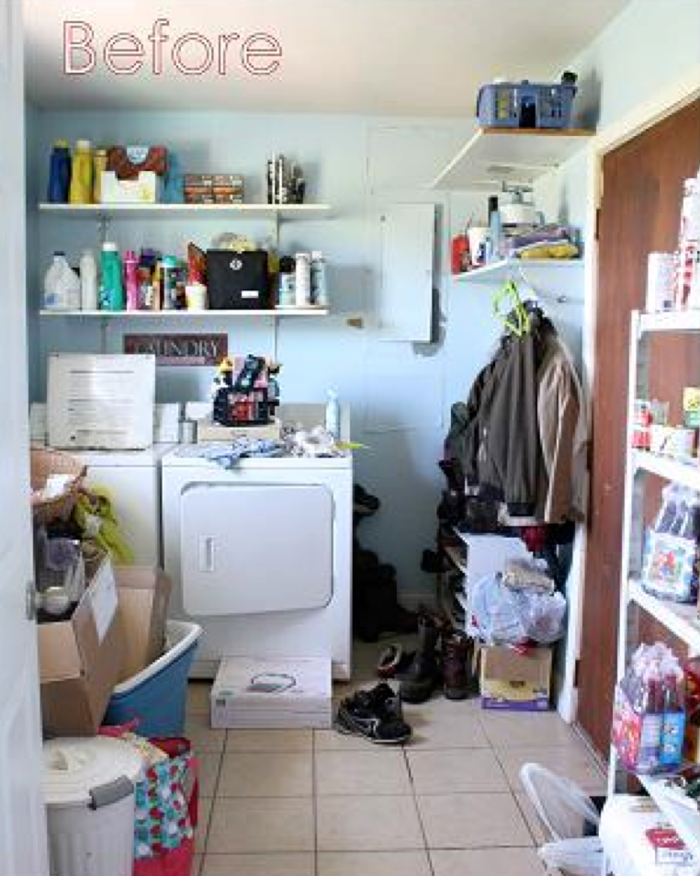

Burrows–Wheeler transform
Transformation algorithm*
Input | All Rotations | Sorting all rows | Taking last character | BWT output
acaacg$ | acaacg$ | $acaacg | $acaacg | gc$aaac
 | $acaacg | aacg$ac | aacg$ac
 | g$acaac | acaacg$ | acaacg$
 | cg$acaa | acg$aca | acg$aca
 | acg$aca | caacg$a | caacg$a
 | aacg$ac | cg$acaa | cg$acaa
 | caacg$a | g$acaac | g$acaac
$acaacg
aacg$ac
acaacg$
acg$aca
caacg$a
cg$acaa
G$acaac
acaacg$
gc$aaac
The transformation is reversible, without needing to store any additional data.
BWT is a compression technique to find repeated patterns and encoding the duplications more compactly. (“bzip” is based on this compression)
* wikipedia.com

Slide 10
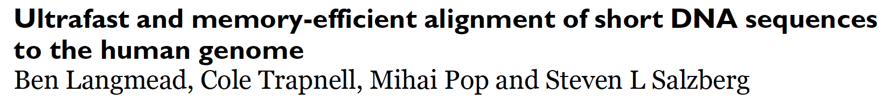
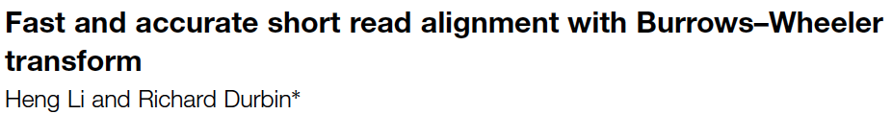
Matching search
Find exact match of aac in the sequence of acaacg
BWT(acaacg) is gc$aaac
Backward searching
aac
aac
aac
$acaacg
aacg$ac
acaacg$
acg$aca
caacg$a
cg$acaa
G$acaac
$acaacg
aacg$ac
acaacg$
acg$aca
caacg$a
cg$acaa
G$acaac
$acaacg
aacg$ac
acaacg$
acg$aca
caacg$a
cg$acaa
G$acaac
Bowtie
BWA

Slide 11
BWT searching
Reference
BWT data
5’
CGTAGCA
3’

Slide 12
backward searching
Reference
Sorted
BWT
5’
CGTAGCA
3’

Slide 13
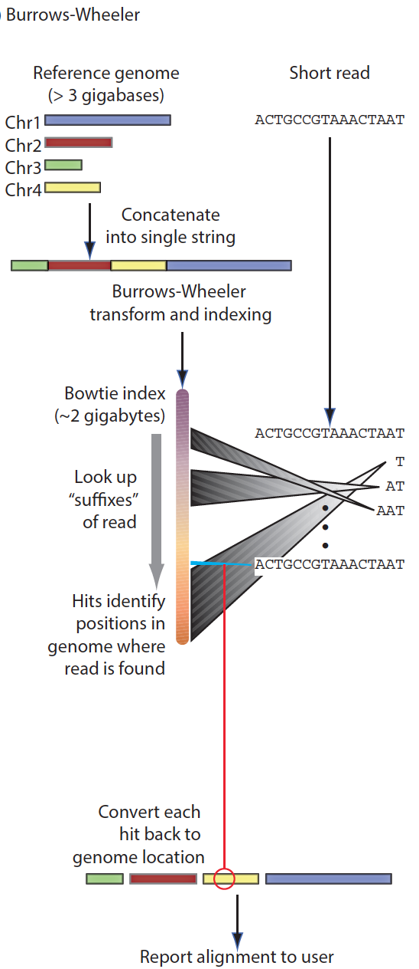
Working flow

Slide 14
Alignment issues
Repeats
Sequencing errors
Polymorphisms (reference and sequenced sample)
Quality of reference genomes (mis-assembly and incomplete genome)
reads
Ref
Notes:
reads are relatively short (30 to 150 bp), making it hard to unambiguously assign them to a specific location in the genome, especially in the presence of sequencing errors and repeat sequences.

Slide 15
Solutions
Unique mapped reads
reads
✗
✓
Ref
Longer reads or Paired-end reads
reads
…
Ref
Tolerance of mismatches or gaps for each alignment

Slide 16
The aligner: BWA
BWA is a software package for mapping low-divergent sequences against a large reference genome, such as the human genome.
It consists of three algorithms: BWA-backtrack, BWA-SW and BWA-MEM.
BWA-backtrack is designed for Illumina sequence reads up to 100bp, while BWA-SW and BWA-MEM are for longer sequences ranged from 70bp to 1Mbp.
BWA-MEM, which is the latest, is generally recommended for high-quality queries as it is faster and more accurate.

Slide 17
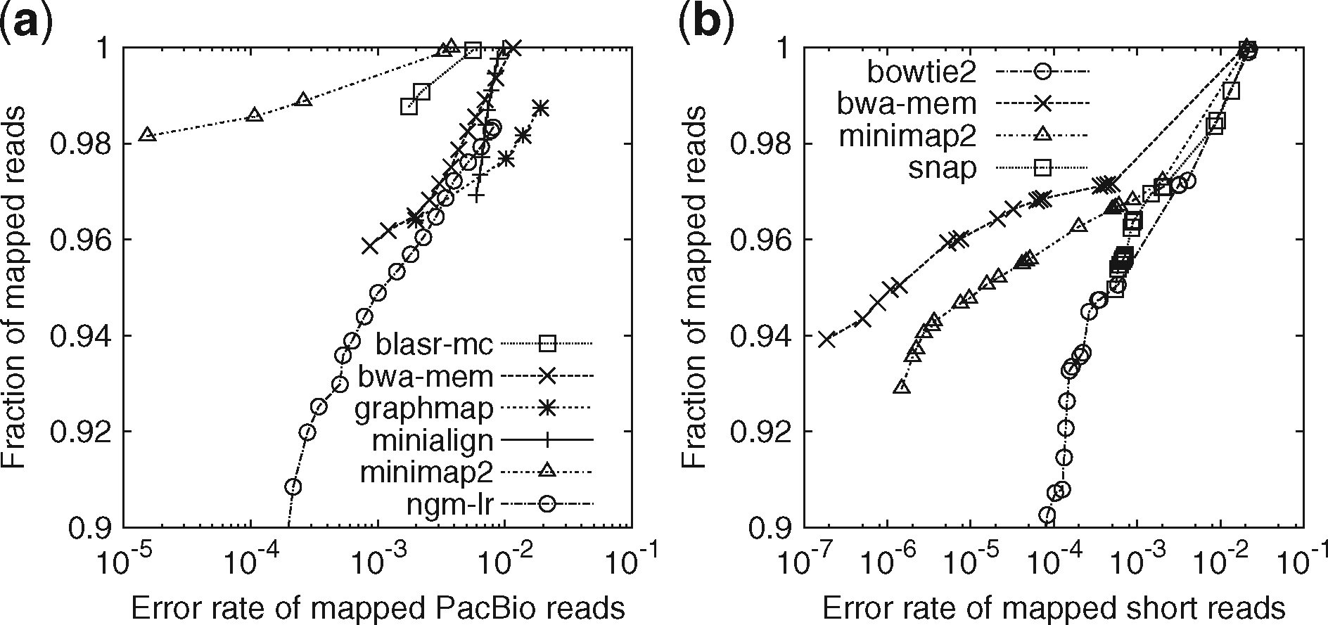
bwa, bowtie2, minimap2
Long-read alignment evaluation
Short-read alignment evaluation
Notes:
Fig. 1. Evaluation on aligning simulated reads. Simulated reads were mapped to the primary assembly of human genome GRCh38. A read is considered correctly mapped if its longest alignment overlaps with the true interval, and the overlap length is ≥10% of the true interval length. Read alignments are sorted by mapping quality in the descending order. For each mapping quality threshold, the fraction of alignments (out of the number of input reads) with mapping quality above the threshold and their error rate are plotted along the curve. (a) Long-read alignment evaluation. 33 088 ≥1000 bp reads were simulated using pbsim (Ono et al., 2013) with error profile sampled from file ‘m131017_060208_42213_*.1.*’ downloaded at http://bit.ly/chm1p5c3. The N50 read length is 11 628. Aligners were run under the default setting for SMRT reads. Kart outputted all alignments at mapping quality 60, so is not shown in the figure. It mapped nearly all reads with 4.1% of alignments being wrong, less accurate than others. (b) Short-read alignment evaluation. 10 million pairs of 150 bp reads were simulated using mason2 (Holtgrewe, 2010) with option ‘–illumina-prob-mismatch-scale 2.5’. Short-read aligners were run under the default setting except for changing the maximum fragment length to 800 bp
Unless provided in the caption above, the following copyright applies to the content of this slide: © The Author(s) 2018. Published by Oxford University Press. All rights reserved. For permissions, please e-mail: journals.permissions@oup.comThis article is published and distributed under the terms of the Oxford University Press, Standard Journals Publication Model (https://academic.oup.com/journals/pages/open_access/funder_policies/chorus/standard_publication_model)

Slide 18
Align queries (reads) to the reference with BWA-MEM
Alignment using “mem”
bwa mem ref.fa reads.fq > se.sam
bwa mem ref.fa pair1.fq pair2.fq > pe.sam

Slide 19
Build a BWA sequence index database
Index reference sequences
bwa index ref.fa
example
bwa index MG1655.fasta
--------output-------------
MG1655.fasta.amb
MG1655.fasta.ann
MG1655.fasta.bwt
MG1655.fasta.pac
MG1655.fasta.sa

Slide 20
Question
chr1
read
chr2
chr3
What parameters/items are needed to describe an alignment between a read and a reference?
read1
read2
chr2
And how about an alignment of a paired-end read to the reference?
Notes:
Chr; pos
orientation
Match, mismatch; gap
Mapping score
Paired?
Distance?
Orientation?

Slide 21
Alignment format: SAM
SAM stands for Sequence Alignment/Map format.
The Sequence Alignment/Map (SAM) format is a generic alignment format for storing read alignments against reference sequences.
The SAM/BAM format, together with SAMtools, enables a generic and modular approach to the analysis of genomic sequencing data.
Notes:
Example of extended CIGAR and the pileup output.
(a) Alignments of one pair of reads and three single-end reads.
(b) The corresponding SAM file. The ‘@SQ’ line in the header section gives the order of reference sequences. Notably, r001 is the name of a read pair. According to FLAG 163 (=1 + 2 + 32 + 128), the read mapped to position 7 is the second read in the pair (128) and regarded as properly paired (1 + 2); its mate is mapped to 37 on the reverse strand (32). Read r002 has three soft-clipped (unaligned) bases. The coordinate shown in SAM is the position of the first aligned base. The CIGAR string for this alignment contains a P (padding) operation which correctly aligns the inserted sequences. Padding operations can be absent when an aligner does not support multiple sequence alignment. The last six bases of read r003 map to position 9, and the first five to position 29 on the reverse strand. The hard clipping operation H indicates that the clipped sequence is not present in the sequence field. The NM tag gives the number of mismatches. Read r004 is aligned across an intron, indicated by the N operation.
(c) Simplified pileup output by SAMtools. Each line consists of reference name, sorted coordinate, reference base, the number of reads covering the position and read bases. In the fifth field, a dot or a comma denotes a base identical to the reference; a dot or a capital letter denotes a base from a read mapped on the forward strand, while a comma or a lowercase letter on the reverse strand.

Slide 22
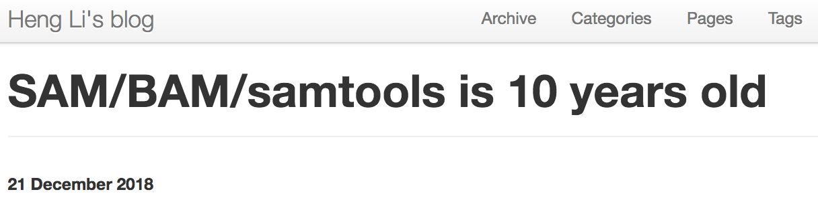
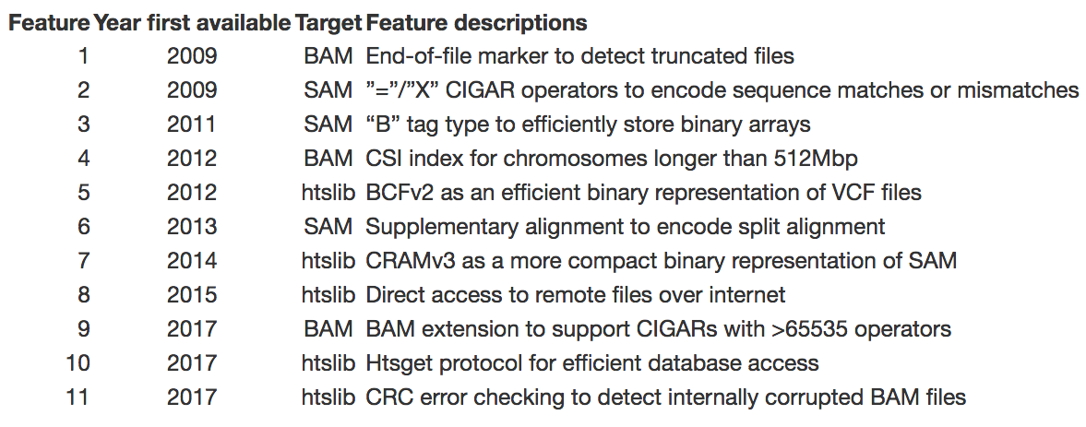
More about SAM/BAM format and samtools

Slide 23
Examples of SAM alignments
@SQ SN:1 LN:307041717
@SQ SN:2 LN:244442276
…
HISEQ:446:C9KP3ANXX:3:1102:8028:81847 99 1 162 40 63M1I61M = 285 234 AATGGTCGTTCATGGCTATTTTCGACAAAAATGGGGGTTGTGTGGCAATTGATCATCGACCAGAAGCTCATACACCTCACCCCACATATGTTTCCTTGCCATAGATCACATTCTTGGATTTCTGG BBCBBGDEGGGGGG>FGGGGGGGGGFGGGGGEGEGGG9C<FGGGDGBGGGGGGGFG>@GGGDGGGGC@GDGGGG0CG>GBG0<CCGGGGGFGGGCFGC0CCGGGG=8800:8@CDD/88@C8DDG NM:i:2 MD:Z:46C77 AS:i:112 XS:i:112 RG:Z:A188-1
HISEQ:446:C9KP3ANXX:3:1305:17136:31643 99 1 205 40 20M1I104M = 379 252 GGCCACTGATCATCGACCAGAAGCTCATACACCTCACCCCACATATGTTTCCTTGCCATAGATCACATTCTTGGATTTCTGGTGGAGACCATTTCTTGGTCAAAAATCCGTAGGTGTTAGCCTTC CCCCCGGGGGGGGGGGGGGGGGGGGGGGGGGGGGGGGGGGGGGGGGGGGGGGGGGGGGGGGGGGGGGGGGGGGGGGGGGGGCFF/::FGGGGG00>0FGGGGGGFBFGBCGGD<F>FGGEG=G88 NM:i:2 MD:Z:5T118 AS:i:112 XS:i:112 RG:Z:A188-1
HISEQ:446:C9KP3ANXX:3:1202:12503:18962 163 1 464 40 125M = 586 247 GTGGAGACCATTTCTTGGTCAAAAATCCGTAGGTGCTAGCCTTCGGTATTATTGAAAATGGTCGTTCATGGCTATTTTCGACAAAATGGGGGTTGGGTGGCAATTGATCATCGACCAGAGGCTCA BBCCCGGGGGGGGGGGGGGGGGGGGGGGGGGGGGGGGGGGGGGGGGGGGGGGGGGGGGGGGGGGGGGGCGFBDF>11<<E0/=C0:00=DGG<.<.;CCCBG@0FF=F86EDDDDCG<DD@B668 NM:i:3 MD:Z:35T59T5C23 AS:i:110 XS:i:115 RG:Z:A188-1

Slide 24
SAM section 1: headers
In the header section, the line starts with ‘@’
@SQ Reference sequence dictionary.
@RG Read group.
…
@SQ SN:1 LN:307041717
@SQ SN:2 LN:244442276

Slide 25
SAM section 2: the alignment section
In SAM, each alignment line has 11 mandatory fields and a variable number of optional fields.
EAS600_70:5:1:3215:930 99 REF 2767401 60 100M = 2767797 498 NTGATATTAACTTGTCCAATATGATCAAATAGCATTAACCCCCCCTCACAACGTCCTGCATAGGGAACACGTTTTCCCCTGTGCACCCACGACTAAATTT !++*+87777@@@@@@@@@@@@@@@@@@@@<::<<99989::32222298&)--28888589179@@@@@############################## NM:i:1 MD:Z:0A99 AS:i:99 XS:i:0
No. | Name | Description
1 | QNAME | Query NAME of the read or the read pair
2 | FLAG | Bitwise FLAG (pairing, strand, mate strand, etc.)
3 | RNAME | Reference sequence NAME
4 | POS 1 | 1-Based leftmost POSition of clipped alignment
5 | MAPQ | MAPping Quality (Phred-scaled)
6 | CIGAR | Extended CIGAR string (operations: MIDNSHP)
7 | MRNM | Mate Reference NaMe (‘=’ if same as RNAME)
8 | MPOS | 1-Based leftmost Mate POSition
9 | ISIZE | Inferred Insert SIZE
10 | SEQ | Query SEQuence on the same strand as the reference
11 | QUAL | Query QUALity (ASCII-33=Phred base quality)
EAS600_70:5:1:3215:930
99
REF
2767401
60
100M
=
2767797
498
NTGATA…
!++*+8…
optional field

Slide 26
FLAG (for single-end or paired-end reads)
Bitwise flag values
Hexadecimal Value | Decimal Value | Description
0x0001 | 1 | The read is paired in sequencing, no matter whether it is mapped in a pair
0x0002 | 2 | The read is mapped in a proper pair (depends on the protocol, normally inferred during alignment)
0x0004 | 4 | The query sequence itself is unmapped
0x0008 | 8 | The second read is unmapped
0x0010 | 16 | The read is reverse complemented
0x0020 | 32 | The second read is reversed
0x0040 | 64 | The read is the first read in a pair
0x0080 | 128 | The read is the second read in a pair
0x0100 | 256 | The alignment is not primary (a read having split hits may have multiple primary alignment records)
0x0200 | 512 | The read fails platform/vendor quality checks
0x0400 | 1024 | The read is either a PCR duplicate or an optical duplicate
16 Reverse complemented
1 + 4 + 128 = 133 paired; segment unmapped;
* http://support.illumina.com/help/SequencingAnalysisWorkflow/Content/Vault/Informatics/Sequencing_Analysis/CASAVA/swSEQ_mCA_BitwiseFlagValues.htm

Slide 27
Problem: explain these decimal FLAG numbers
73
81
192
Hexadecimal Value | Decimal Value | Description
0x0001 | 1 | The read is paired in sequencing, no matter whether it is mapped in a pair
0x0002 | 2 | The read is mapped in a proper pair (depends on the protocol, normally inferred during alignment)
0x0004 | 4 | The query sequence itself is unmapped
0x0008 | 8 | The second read is unmapped
0x0010 | 16 | The read is reverse complemented
0x0020 | 32 | The second read is reversed
0x0040 | 64 | The read is the first read in a pair
0x0080 | 128 | The read is the second read in a pair
0x0100 | 256 | The alignment is not primary (a read having split hits may have multiple primary alignment records)
0x0200 | 512 | The read fails platform/vendor quality checks
0x0400 | 1024 | The read is either a PCR duplicate or an optical duplicate
Notes:
1 + 8 + 64 = 73 paired; the next segment unmapped; the first segment in the template

Slide 28
MAPQ: Mapping quality
MAPQ = −10 log₁₀ Prob{error mapping}, rounded to the nearest integer.
0: Prob(error mapping) = 10^{0/(-10)} = 1
10: Prob(error mapping) = 10^{10/(-10)} = 0.1
30: Prob(error mapping) = 10^{30/(-10)} = 0.001
40: Prob(error mapping) = 10^{40/(-10)} = 0.0001

Slide 29
Factors influencing mapping quality
Alignment quality (matches, mismatches, gaps)
s: CTGTTGCT
||||||
t: ATGCTGCA
Mapping ambiguity
reads
Ref
Mapping quality ≠ Alignment quality

Slide 30
A read with a high mapping score
A read alignment with a mapping quality 30 or above usually implies:
The read is mapped at the location with a high alignment score and the read is not mapped to anywhere else or alignments at other locations are not as good as this alignment.

Slide 31
CIGAR
Example 1: 100M
Example 2: 24M188N83M
Example 3: 80M1I20M2D60M
Example 4: 98M2S
Operation | Description
M | alignment match (can be a sequence match or mismatch)
I | insertion to the reference
D | deletion from the reference
N | skipped region from the reference
S | soft clipping (clipped sequences present in SEQ)
H | hard clipping (clipped sequences NOT present in SEQ)
P | padding (silent deletion from padded reference)
= | sequence match
X | sequence mismatch
For mRNA-to-genome alignment, an N operation represents an intron.
P, =, and X are rarely used.

Slide 32
Binary Alignment/Map format (BAM)
To improve the performance, a companion format Binary Alignment/Map (BAM) was designed.
BAM is the binary representation of SAM and keeps exactly the same information as SAM.
Table. File size of two example files
File type | Storage usage
SAM | 313 M
BAM | 97 M

Slide 33
SAMtools
SAMtools is a popular open-source software package for sequence alignment manipulation. It is a reliable tool for almost all bioinformatists who work on NGS data.
-- indexing
faidx index/extract FASTA
index index alignment
-- editing
calmd recalculate ...
fixmate fix mate information
reheader replace BAM header
rmdup remove PCR duplicates
targetcut cut fosmid regions
-- file operations
bamshuf shuffle and group ...
cat concatenate BAMs
merge merge sorted alignments
mpileup multi-way pileup
sort sort alignment file
split splits a file by read group
bam2fq converts a BAM to a FASTQ
-- stats
bedcov read depth per BED region
depth compute the depth
flagstat simple stats
idxstats BAM index stats
phase phase heterozygotes
stats generate stats (former bamcheck)
-- viewing
flags explain BAM flags
tview text alignment viewer
view SAM<->BAM<->CRAM conversion

Slide 34
Conversion between SAM and BAM
For efficient computation and storage, SAM is often converted to BAM. Sorting and indexing the alignment facilitate the following analyzing procedures.
converting:
samtools view aln.sam -o aln.bam
sorting:
samtools sort aln.bam -o alnsort.bam
indexing:
samtools index alnsort.bam

Slide 35
Visualization
samtools tview alnsort.bam ref.fasta
1st line: the genome coordinates
541 551 561 571 581 591
ATGCCGAACGTATTTTTGCCGAACTTTTGACGGGACTCGCCGCCGCCCAGCCGGGGTTCCCGCTGGCGC
.....................................................................
... ,,,,,,,,,,,,,,,,,,,,,,,,,,,,,,,,,,,,,,,,,,,,,,,,,,,,,,,,,,,,,,,,,
,,,, ,,,,,,,,,,,,,,,,,,,,,,,,,,,,,,,,,,,,,,,,,,,,,,,,,,,,,,,,,,,,,,,
,,,,,, ,,,,,,,,,,,,,,,,,,,,,,,,,,,,,,,,,,,,,,,,,,,,,,,,,,,,,,,,,n
,,,,,,,,,,,,,,,,,,,,,,,,,,, ,,,,,,,,,,,,,,,,,,,,,,,,,,,,,,,,
................................................... C................
,,,,,,,,,,,,,,,,,,,,,,,,,,,,,,,,,,,,,,,,,,,,,,,,,,,,,t ,,,,,,,
2nd line: the reference sequence
3rd line: the consensus sequence, . indicates the identical sequence to the reference genome
the rest of lines: alignment details
Notes:
In this view, the first line shows the genome coordinates, the second line shows the reference sequence, and the third line shows the consensus sequence determined from the aligned reads. Throughout tview, a . indicates a match to the reference genome.

Slide 36
Integrative Genomics Viewer (IGV)
The Integrative Genomics Viewer (IGV) is a high-performance visualization tool for interactive exploration of large, integrated genomic datasets.
IGV focus on the integrative nature of genomic studies, with support for both array-based and next-generation sequencing data, and the integration of phenotypic data.
James T. Robinson, et al., Nature Biotechnology 29:24–26 (2011)
Helga Thorvaldsdóttir, et al., Briefings in Bioinformatics 14:178-192 (2013)
www.broadinstitute.org/igv

Slide 37
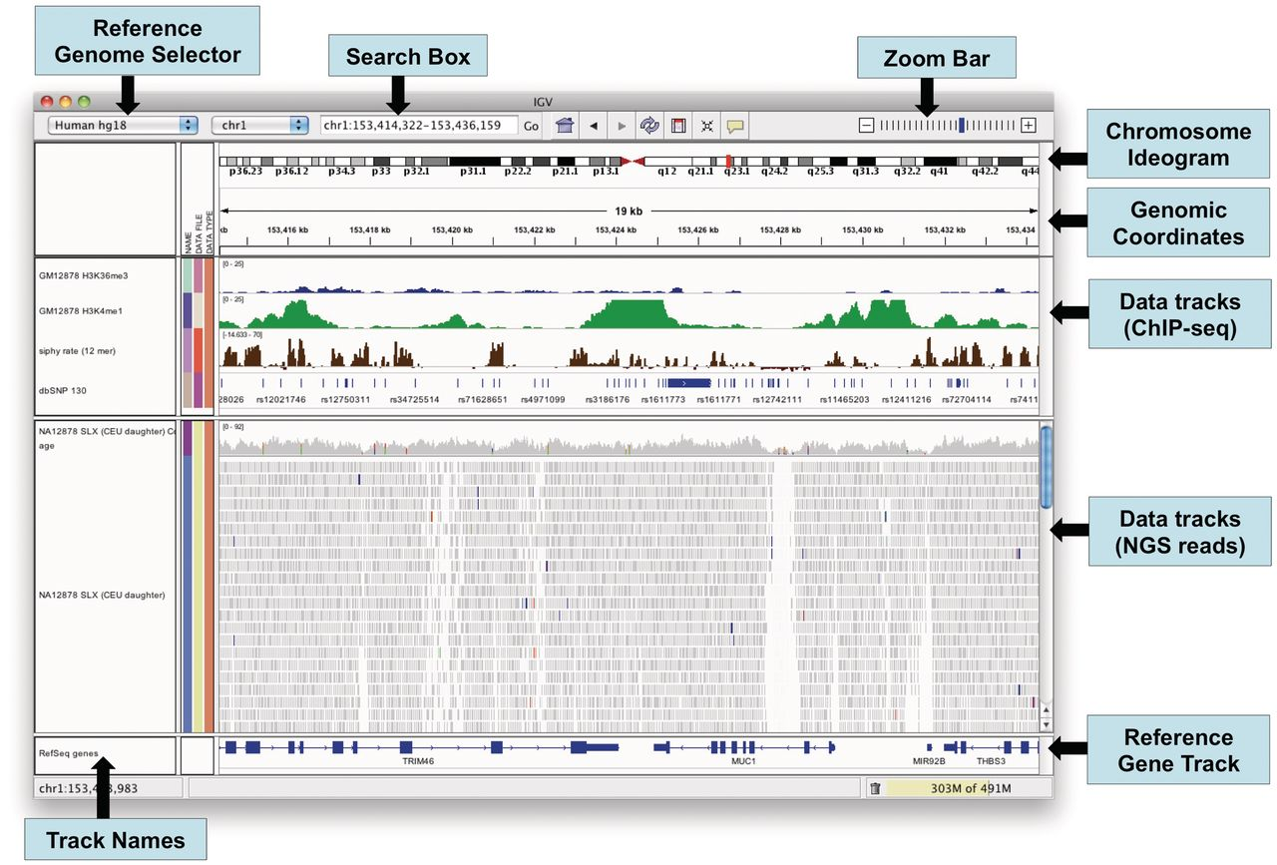
The IGV application window.
Notes:
The IGV application window.

Slide 38
Data for IGV
Reference genomes (build-in or external references)
Data format:
Non-indexed formats: GFF, BED and WIG.
Indexed formats: BAM (sequence alignments)
For example:
A reference genome: .fasta
A genome annotation file: .gff3 (optional)
An alignment file: .bam (plus .bai index file)

Slide 39
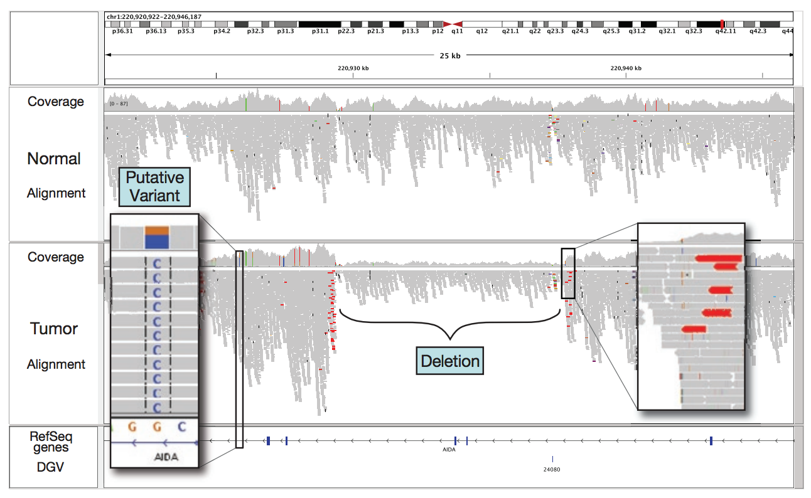
IGV example
Loci with a large percentage of mismatches relative to the reference are flagged in the coverage plot as color-coded bars.
Alignments with unexpected inferred insert sizes are indicated by color.
Evidence for a ~10-kb deletion in the tumor sample not present in the normal.

Slide 40
Review
One of short-read alignment algorithms – BWT
An aligner - BWA
Alignment standard format – SAM and BAM
A tool to handle alignments - SAMtools
An alignment visualization tool - IGV

